Slide 1
How to use this slide deck template
Make a copy of this document
Edit the appropriate slide for your department’s project
Edit the year and project number in the top right corner
Font family is “Roboto Condensed - Extra Bold”
Font size is 100
Use the guides to properly align your department number
To display guides, go to “View > Guides > Show guides”
Use the guidelines provided in Canvas to build your poster. There are many examples on display on the 4th floor of East Hall as well.

Slide 2
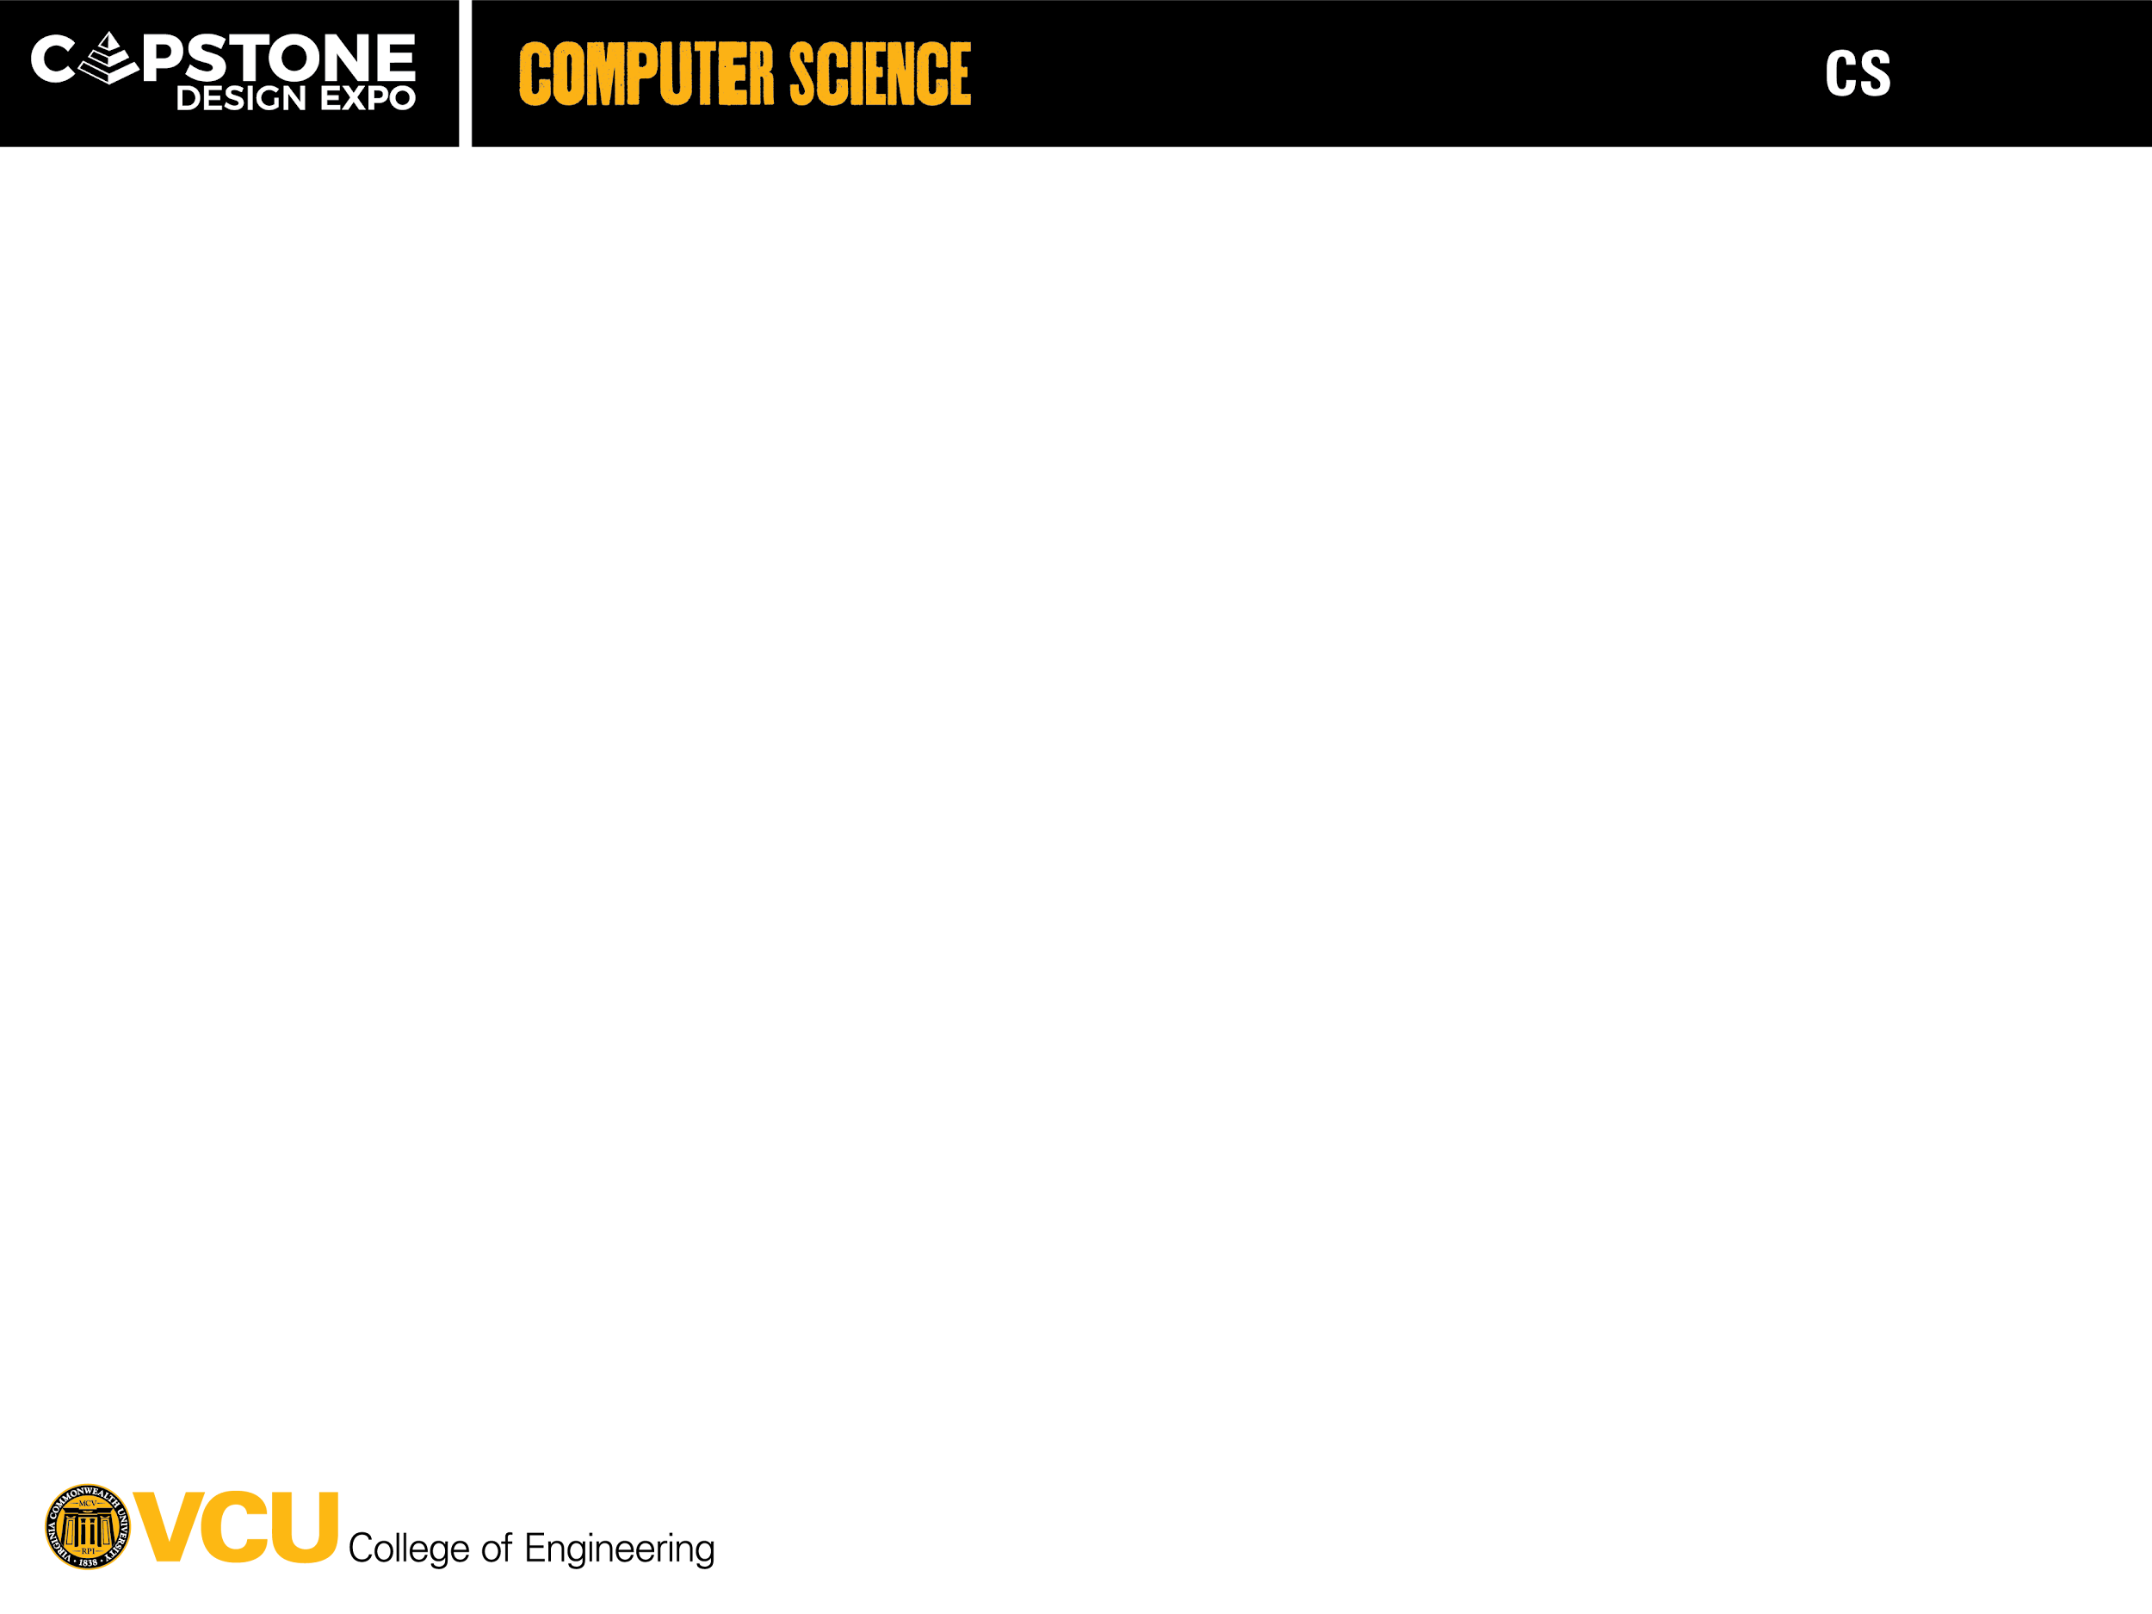
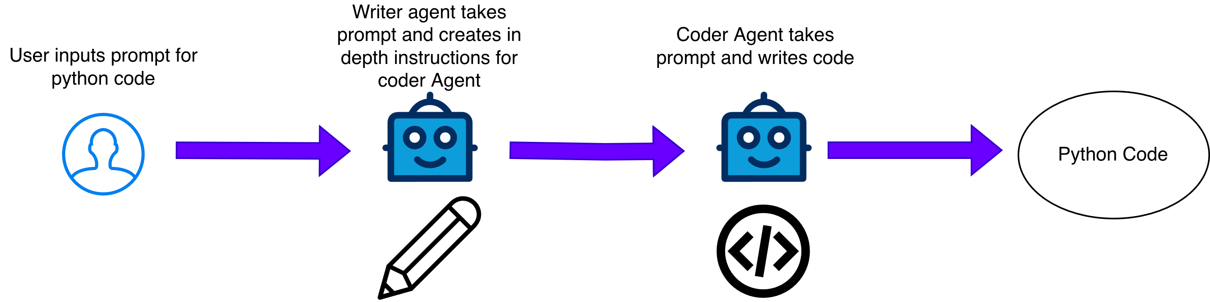
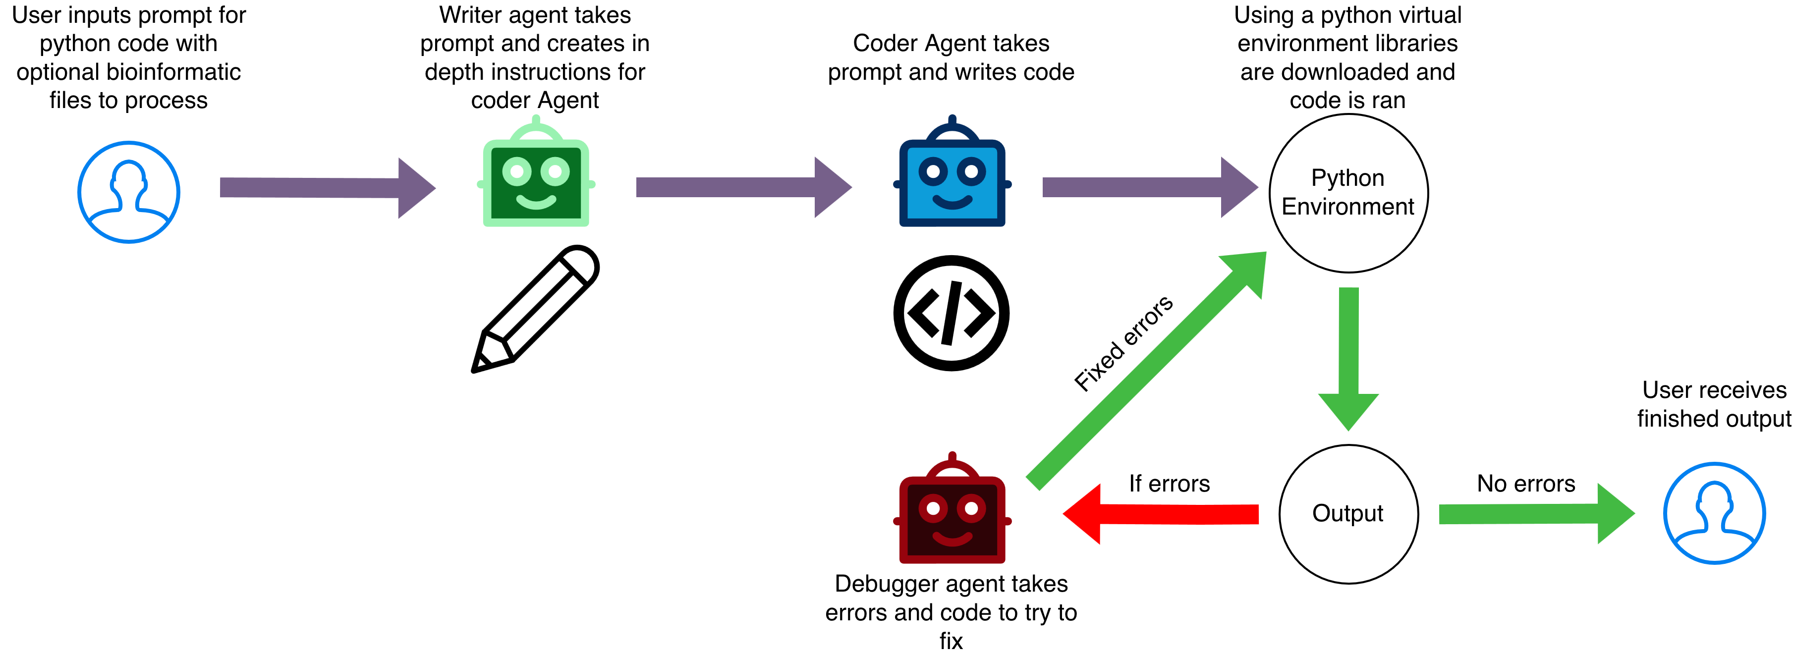
26-335
AI Agents for Bioinformatics
Team members: Ozi Jawad, Carter Struck, Mack Hicks, Sona James | Faculty adviser: Tomasz Arodz, Ph.D. | Partner: VCU College of Engineering | Mentor: Tomasz Arodz, Ph.D
Objective
Develop a functional multi-agent AI system using open-source large language models (LLMs) capable of processing, coding, and interpreting genomic datasets.
Design and implement an AI-based tool that can automatically generate and execute Python code for bioinformatic tasks.
Deliver accurate and reliable solutions generated by the AI system.
Reduce time required to process and interpret data by 50% compared to traditional bioinformatic workflows.
Example Input Output
Prompt: Write a Python function that calculates the GC content given a DNA sequence.
def gc_content(seq): # START_OF_FUNCTION count = 0 for i in seq: if i == "G" or i == "C": count += 1 return count / len(seq) * 100 # End the function after implementation with marker # END_OF_FUNCTION # Example DNA sequences to test the function dna1 = "ATGCGC" dna2 = "ATATAT" dna3 = "GGCCGGCC" # Test the function print(f"GC content of {dna1}: {gc_content(dna1):.2f}%") print(f"GC content of {dna2}: {gc_content(dna2):.2f}%") print(f"GC content of {dna3}: {gc_content(dna3):.2f}%") OUTPUT:
GC content of ATGCGC: 66.67% GC content of ATATAT: 0.00% GC content of GGCCGGCC: 100.00%
Design Constraints
Modal Must run on NVDIA A100 40GB
LLMs parameter sizes limited to 20 Billion
Open Source LLMs only
No Chinese LLMs
Reasonable completion speed for output
Agents must debug and produce runnable python code
Design Choices
We have chosen StarCoder for both the writing and the coding agents for system design purposes.
This choice was made to ensure prototype alignment and reduce the system’s complexity while designing and testing the overall workflow of the system.
Before testing other LLMs for our specified purposes, implementing the system with a single LLM allows us to build a robust system that links the two types of LLMs needed for our project’s purposes before attempting to try it on other LLMs.
Problem
The problem is the complexity of current bioinformatic tasks dealing with large datasets.
The goal of the agent is to simplify this process for non-bioinformaticians working on genomic datasets that often require a bioinformatician to decipher.
To solve this problem, we propose a multi-agent AI system capable of reading genomic data, analyzing it, and producing useful and understandable insights.
Current Design
Goal Design

